Slide 1

Case Study- Airbnb
. Investigated about a really successful startup Airbnb which in a very little time grew into a large business. We analyzed how using business analytics Airbnb grew by leaps and bounds.

Slide 2
About the company
Airbnb is an American company that operates on an online marketplace for lodging, homestays for vacation, renting apartments, and tourism activities. The company is based in San Francisco, California. It was founded by Brian Chesky, Joe Gebbia, Nathan Blecharczyk in 2008
Airbnb is a huge success story. In just a few years, the company has become a giant in the travel industry, providing travelers with an alternative to expensive hotels, and providing people who have rooms, apartments, or homes to rent their property and generate a new source of income.
In 2012, travelers booked over 5 million nights with Airbnb’s service. Impressive right but it all started small, and its founders—adherents to the “Lean Startup mindset” took a very methodical approach to their success

Slide 3
Approach of the company
The founders of Airbnb wanted to disrupt the market by refining and introducing new products. The founder Joe Zadeh on running deep analysis and looking through different models wanted to introduce “professional photography” as a new feature to the enterprise.
It started with a hypothesis: “Hosts with professional photography will get more business. And hosts will sign up for professional photography as a service.” This is where the founders’ gut instincts came in: they had a sense that professional photography would help their business.

Slide 4

The Change the Company Planned
Now it was time to work upon this gut instinct to become better. But rather than implementing it outright, they built a Minimum Viable Product (MVP) to quickly test their hypothesis, which will help them to test if their idea can be profitably monetized or not.

Slide 5
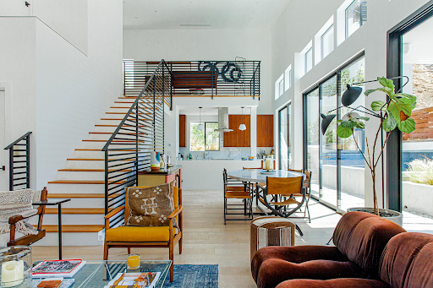
Results of the New Implication
After implementing the MVP model the results came out promising. It showed two to three times more bookings than the market average. This validated their first hypothesis. And it turned out that hosts were wildly enthusiastic to hire these photographers from Airbnb to boost their sales as well. Hence the hypothesis came out to be true and it was a success for the company.

Slide 6
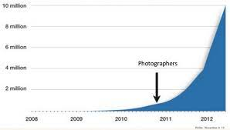
In mid-to-late 2011, Airbnb had 20 photographers in the field taking pictures for hosts. At this time Airbnb was starting to show the hockey stick model graph in terms of nights booked.

Slide 7
Some More Improvements by the Company
To move things further Airbnb took some steps to improve the model. They started putting watermarks for authenticity. It got customer service to offer professional photography as a service when renters or potential renters called in, so now they offered photography services as well to those who asked which in turn demanded higher picture qualities. The key metric it tracked was shot per month. This metric was a proven one by the MVP results hence the total shoot was recorded. By February 2012, Airbnb was doing nearly 5,000 shoots per month and continuing to accelerate the growth of the professional photography program.

Slide 8

Here is an example of the of the earlier additional implementation by Airbnb.

Slide 9

Summary of the Case Study
Airbnb worked on a hunch the founders had and worked towards it changing and improving every step of the way. They tested the model with the minimal viable product (MVP) which requires the least effort and investment to check if their hunch will work or not. When the experiment showed good results, they built the necessary components and rolled them out to all customers.

Slide 10

Business Analytics Lesson Learnt
Growth can come from any aspect of the business even from where you least expect it. For Airbnb, it was photography that tells us every aspect of the analytics is important. - Define success beforehand and work towards it. MVPs are one of the best options to test your idea and product.

